Slide 1
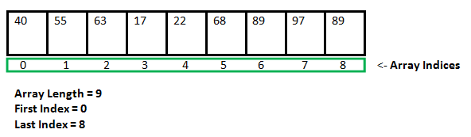
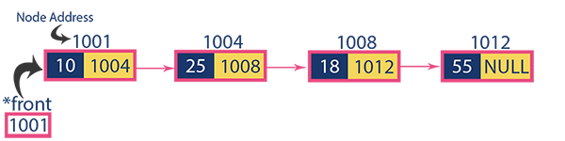
Linked List
The linked list is a linear data structure that contains a sequence of elements such that each element links to its next element in the sequence. Each element in a linked list is called "Node".
Difference Between Linked List and Array

Slide 2
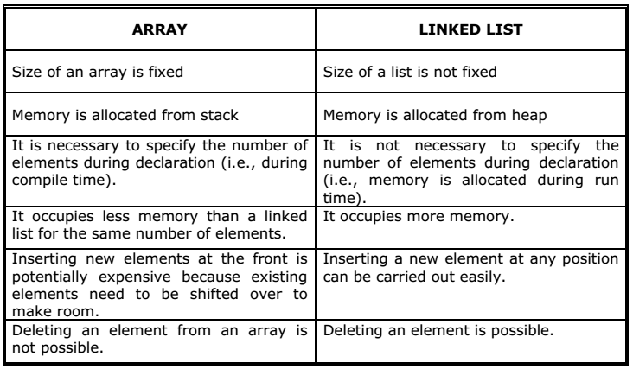
Difference Between Linked List and Array

Slide 3

Linked List
A linked list is a sequence of data structures, which are connected together via links.
In a single linked list, the address of the first node is always stored in a reference node known as “head”
Always next part (reference part) of the last node must be NULL.

Slide 4
Operations on Single Linked List
The following operations are performed on a Single Linked List
Insertion
Deletion
Display
Insertion
In a single linked list, the insertion operation can be performed in three ways. They are as follows...
Inserting At Beginning of the list
Inserting At End of the list
Inserting At Specific location in the list

Slide 5
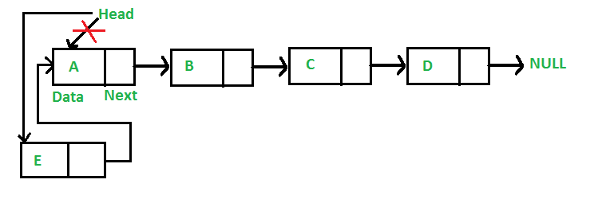
Inserting At Beginning of the list
We can use the following steps to insert a new node at beginning of the single linked list...
Step 1 - Create a newNode with given value.
Step 2 - Check whether list is Empty (head == NULL)
Step 3 - If it is Empty then, set newNode→next = NULL and head = newNode.
Step 4 - If it is Not Empty then, set newNode→next = head and head = newNode.

Slide 6
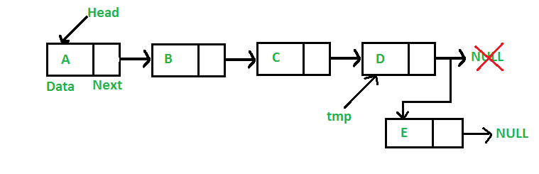
Inserting At End of the list
We can use the following steps to insert a new node at end of the single linked list...
Step 1 - Create a newNode with given value and newNode → next as NULL.
Step 2 - Check whether list is Empty (head == NULL).
Step 3 - If it is Empty then, set head = newNode.
Step 4 - If it is Not Empty then, define a node pointer temp and initialize with head.
Step 5 - Keep moving the temp to its next node until it reaches to the last node in the list (until temp → next is equal to NULL).
Step 6 - Set temp → next = newNode.

Slide 7
Inserting At Specific location in the list (After a Node)
We can use the following steps to insert a new node after a node in the single linked list...
Step 1 - Create a newNode with given value.
Step 2 - Check whether list is Empty (head == NULL)
Step 3 - If it is Empty then, set newNode → next = NULL and head = newNode.
Step 4 - If it is Not Empty then, define a node pointer temp and initialize with head.
Step 5 - Keep moving the temp to its next node until it reaches to the node after which we want to insert the newNode (until temp1 → data is equal to location, here location is the node value after which we want to insert the newNode).
Step 6 - Every time check whether temp is reached to last node or not. If it is reached to last node then display 'Given node is not found in the list!!! Insertion not possible!!!' and terminate the function. Otherwise move the temp to next node.
Step 7 - Finally, Set 'newNode → next = temp → next' and 'temp → next = newNode'

Slide 8
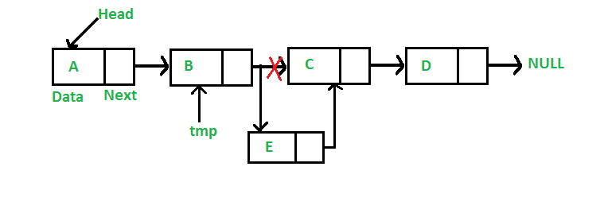

Slide 9
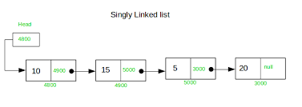
Displaying a Single Linked List
We can use the following steps to display the elements of a single linked list...
Step 1 - Check whether list is Empty (head == NULL)
Step 2 - If it is Empty then, display 'List is Empty!!!' and terminate the function.
Step 3 - If it is Not Empty then, define a Node pointer 'temp' and initialize with head.
Step 4 - Keep displaying temp → data with an arrow (--->) until temp reaches to the last node
Step 5 - Finally display temp → data with arrow pointing to NULL (temp → data ---> NULL).

Slide 10
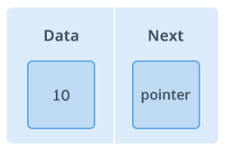
Code
class Node {
constructor(element)
{
this.element = element;
this.next = null
}
}
class LinkedList {
constructor()
{
this.head = null;
this.size = 0;
}

